Slide 1
How to Increase Your Star Power: An Analysis of Yelp Business Data to Identify Restaurant Characteristics That Affect Yelp Users’ Restaurant Ratings
Christine Vaughan
Spring 2017

Slide 2
Outline
Statement of the problem
Analytical approach
Findings
Recommendations

Slide 3
Outline
Statement of the problem
Analytical approach
Findings
Recommendations

Slide 4
Restaurants Need to Know How to Improve to Attract and Retain Customers
Identifying the modifiable characteristics of restaurants that most strongly predict customers’ ratings would help restaurants know what changes are most likely to increase customer satisfaction
Yelp has data on several restaurant characteristics and ratings (“stars”) across numerous restaurants and cities:
26,729 restaurants representing 67 categories of cuisine (e.g., Mexican food, hot dogs)
298 cities

Slide 5
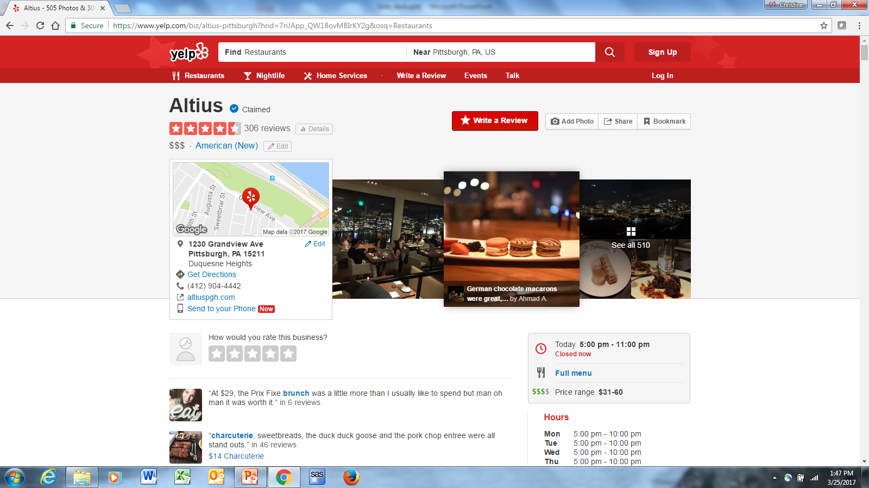
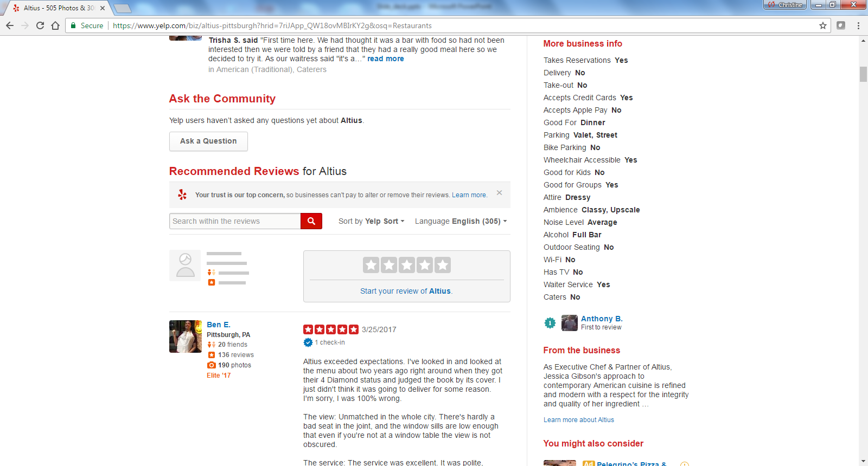
Example of a Restaurant’s Yelp Page

Slide 6
Outline
Statement of the problem
Analytical approach
Findings
Recommendations

Slide 7
I Analyzed Yelp Data to Examine the Effects of Restaurant Characteristics on Users’ Ratings
I estimated 4 multiple regression models with specifications that differed in terms of whether:
Cities were modeled as:
a fixed effect in a single-level linear regression model, or
a random effect in a multilevel linear regression model
Parameter estimates were:
weighted by the number of reviews for restaurants (i.e., restaurants with more reviews have more influence in the analysis),
or not weighted
Estimating models with different specifications allows us to see how parameter estimates change as assumptions change and identify the restaurant characteristics with the most robust effects on ratings across models

Slide 8
I Analyzed Yelp Data to Examine the Effects of Restaurant Characteristics on Users’ Ratings
All restaurant characteristics of interest were included as covariates in all 4 regression models
This allowed us to obtain parameter estimates for each characteristic that were adjusted for the potentially confounding effects of other restaurant characteristics
This analysis will allow us to make statements such as:
“All else equal, restaurants that have wi-fi have .5 more stars than restaurants without wi-fi.”

Slide 9
Outline
Statement of the problem
Analytical approach
Findings
Recommendations

Slide 10
The Two Unweighted Models Yielded Results That Were Very Similar to Each Other, As Did the Two Weighted Models
Predictor | Model 1: Unweighted linear regression model, cities modeled as a fixed effect | Model 2: Unweighted multilevel linear regression model with cities are modeled as a random effect | Model 3: Weighted linear regression model with cities modeled as a fixed effect | Model 4: Weighted multilevel linear regression model with cities modeled as a random effect
touristy | -0.40 | -0.41 | -0.40 | -0.41
credit | -0.28 | -0.29
intimate | 0.20 | 0.20 | 0.16 | 0.15
hipster | 0.19 | 0.19 | 0.12 | 0.12
classy | 0.16 | 0.15 | 0.13 | 0.13
upscale | 0.15 | 0.14 | 0.11 | 0.10
caters | 0.15 | 0.14 | 0.09 | 0.09
attire | 0.14 | 0.15 | 0.09 | 0.09
lot | 0.14 | 0.13 | 0.16 | 0.16
divey | 0.14 | 0.14 | 0.09 | 0.09
fullbar | -0.12 | -0.12 | -0.14 | -0.14
street | 0.11 | 0.12 | 0.15 | 0.16
dessert | 0.11 | 0.11 | 0.07 | 0.07
noisier | -0.11 | -0.11 | -0.09 | -0.09
romantic | 0.11 | 0.10 | 0.07 | 0.06
trendy | 0.08 | 0.08 | 0.09 | 0.09
brunch | 0.08 | 0.08 | 0.06 | 0.06
gfg | 0.08 | 0.08 | -0.05 | -0.05
breakfast | -0.08 | -0.08 | -0.10 | -0.10
delivery | -0.07 | -0.07 | -0.11 | -0.11
wheelch | 0.06 | 0.05
latenight | -0.05 | -0.04 | -0.14 | -0.14
lunch | 0.04 | 0.04 | -0.02 | -0.03
beer_and_wine | 0.04 | 0.04
waiter | 0.03 | 0.03
price | -0.03 | -0.03
dinner | 0.03 | 0.03
takesres | 0.03 | 0.03 | -0.05 | -0.05
TV | 0.03 | 0.02
valet |  |  | 0.06 | 0.06
wifi |  |  | 0.02 | 0.02
outdoor |  |  | -0.02 | -0.02
gfk |  |  | -0.03 | -0.03
takeout |  |  | -0.06 | -0.06

Slide 11
Several Restaurant Characteristics Had a Significant, Positive Association with Restaurant Ratings in All Models
Predictor | Model 1: Unweighted linear regression model, cities modeled as a fixed effect | Model 2: Unweighted multilevel linear regression model with cities are modeled as a random effect | Model 3: Weighted linear regression model with cities modeled as a fixed effect | Model 4: Weighted multilevel linear regression model with cities modeled as a random effect
intimate | 0.20 | 0.20 | 0.16 | 0.15
hipster | 0.19 | 0.19 | 0.12 | 0.12
classy | 0.16 | 0.15 | 0.13 | 0.13
upscale | 0.15 | 0.14 | 0.11 | 0.10
divey | 0.14 | 0.14 | 0.09 | 0.09
romantic | 0.11 | 0.10 | 0.07 | 0.06
trendy | 0.08 | 0.08 | 0.09 | 0.09
caters | 0.15 | 0.14 | 0.09 | 0.09
has nicer attire | 0.14 | 0.15 | 0.09 | 0.09
parking lot available | 0.14 | 0.13 | 0.16 | 0.16
street parking available | 0.11 | 0.12 | 0.15 | 0.16
good for dessert | 0.11 | 0.11 | 0.07 | 0.07
good for brunch | 0.08 | 0.08 | 0.06 | 0.06
Across all models and characteristics, having an intimate ambience had the strongest association with restaurant ratings: restaurants with an intimate ambience had, on average, .15-.20 more stars than restaurants without an intimate ambience.

Slide 12
Some Restaurant Characteristics Had a Significant, Negative Association with Restaurant Ratings in All Models
Predictor | Model 1: Unweighted linear regression model, cities modeled as a fixed effect | Model 2: Unweighted multilevel linear regression model with cities are modeled as a random effect | Model 3: Weighted linear regression model with cities modeled as a fixed effect | Model 4: Weighted multilevel linear regression model with cities modeled as a random effect
touristy ambience | -0.40 | -0.41 | -0.40 | -0.41
full bar available (vs. not serving alcohol) | -0.12 | -0.12 | -0.14 | -0.14
noisier | -0.11 | -0.11 | -0.09 | -0.09
good for breakfast | -0.08 | -0.08 | -0.10 | -0.10
good for late night | -0.05 | -0.04 | -0.14 | -0.14
delivery available | -0.07 | -0.07 | -0.11 | -0.11
Across all models and characteristics, having a touristy ambience had the strongest association with restaurant ratings: restaurants with a touristy ambience had, on average, .40 fewer stars than restaurants without a touristy ambience.

Slide 13
Outline
Statement of the problem
Analytical approach
Findings
Recommendations

Slide 14
Overall, It Seems That “Nicer” Restaurants Have More Stars
Specifically, restaurants tended to have more stars if they:
Had an ambience classified as intimate, hipster, classy, upscale, divey, romantic, or trendy, and not touristy
Specified nicer attire
Kept the noise down
Did not have a full bar
Offered catering but not delivery
Had a parking lot or street parking available
Were good for dessert or brunch but not for breakfast or late night meals

Slide 15
But Can Restaurants Boost Their Ratings By Modifying These Characteristics?
Maybe…
Findings are consistent with the notion that the characteristics that were significantly associated with restaurant ratings causally influenced ratings.
However, correlation does not equal causation: Due to the non-experimental design of the study, we can’t rule out the possibility that the observed associations were accounted for by other variables not included in this analysis.
Moreover…

Slide 16
Findings May Not Generalize to Customers Who Don’t Use Yelp
Restaurant ratings are made by Yelp users, who might not be representative of the broader population of customers that restaurants wish to attract and retain.
For example, Yelp users might be younger, more comfortable with technology, better-educated, and/or wealthier than customers who do not use Yelp.
To the extent that Yelp users differ from the target population of restaurant customers, findings regarding the effects of restaurant characteristics on restaurant ratings may not generalize beyond this sample.
For example, the significant effect of an “intimate” ambience on restaurant ratings may hold primarily in a younger population of Yelp users and may not hold in an older population.

Slide 17
Restaurants Might Wish to Test out Modifications on a Trial Basis
Given the limitations noted, restaurants might want to proceed cautiously in implementing changes based on findings from this study.
For example, restaurants could choose one characteristic to modify (e.g., making their ambience less “touristy” and more “intimate”) and conduct their own “experiment” in which they modify the characteristic and keep track of subsequent changes in ratings and revenue to determine whether the change has the expected, positive effect.

Slide 18
Restaurants Might Wish to Consider Improving, Rather than Eliminating, Characteristics That Showed a Negative Association with Ratings
These findings indicate whether a characteristic is associated with ratings, but do not explain why certain characteristics are positively or negatively associated with ratings.
For example, rather than eliminating delivery, restaurants might want to consider what it is about delivery that explains its negative association with ratings (e.g., mistakes in orders are more common and harder to rectify?) and try to improve those aspects of delivery.
Future research should seek to explain the associations between restaurant characteristics and ratings, perhaps by mining the text in Yelp user reviews.

Slide 19
Thank you!

